Slide 1


Slide 2


Slide 3


Slide 4


Slide 5
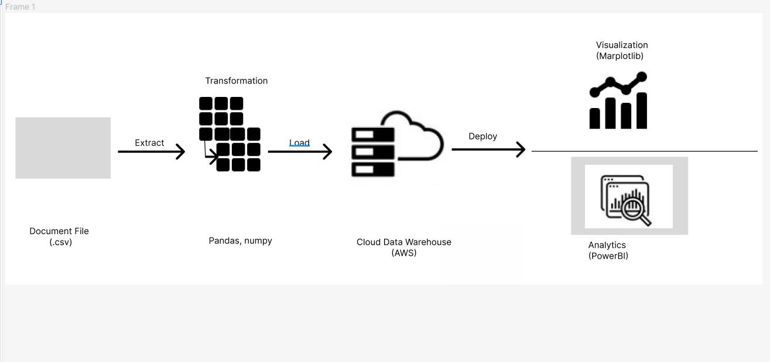
Graphical View of ETL Tools :

Slide 6
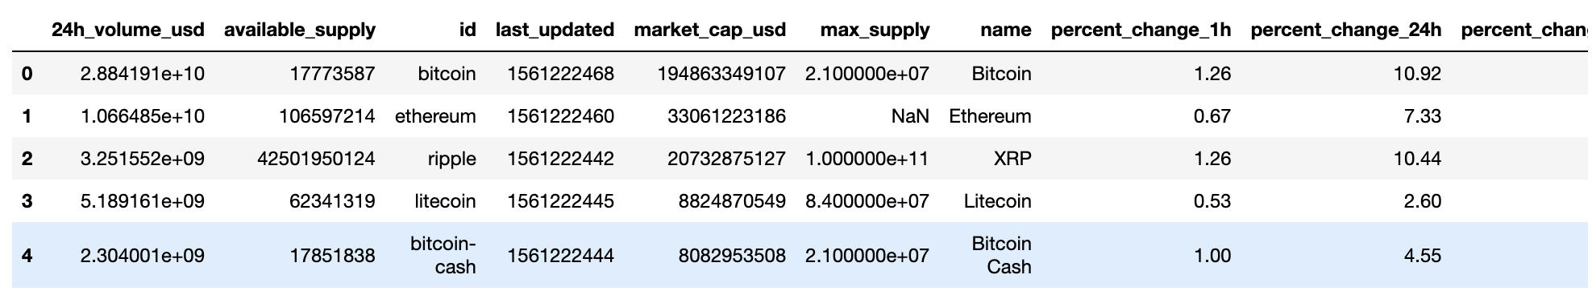
Data from Kaggle
https://github.com/rrmolin/Exploring-the-Bitcoin-Cryptocurrency-Market-DataCamp-project

Slide 7


Slide 8


Slide 9
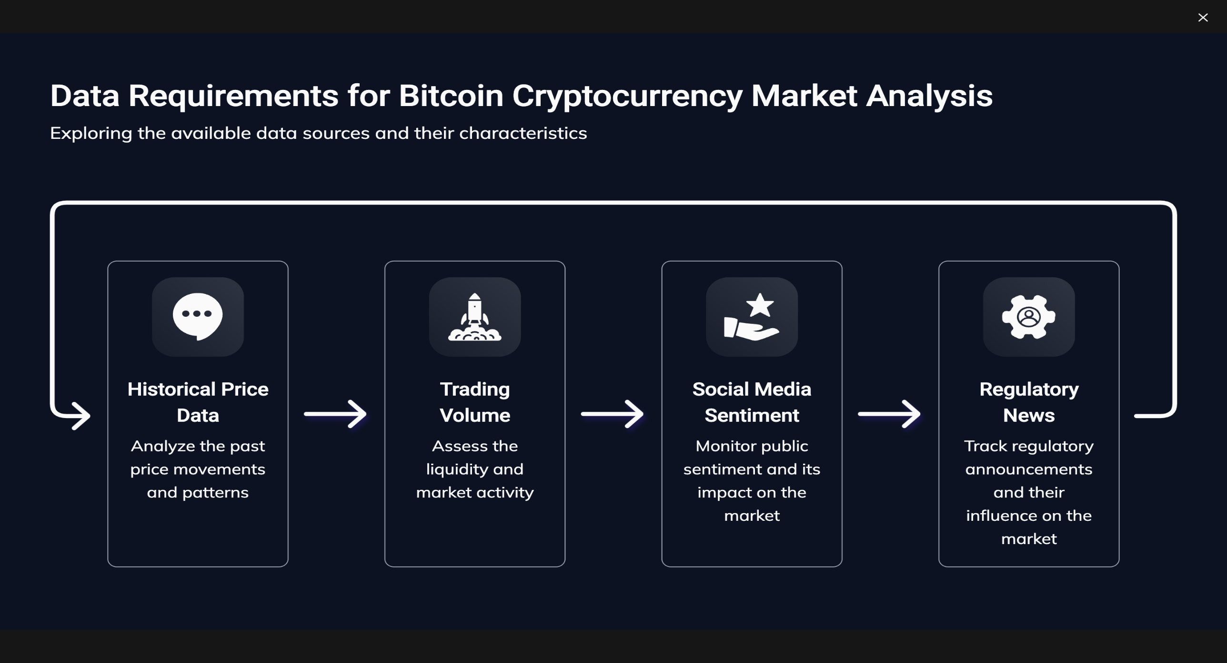

Slide 10


Slide 11


Slide 12
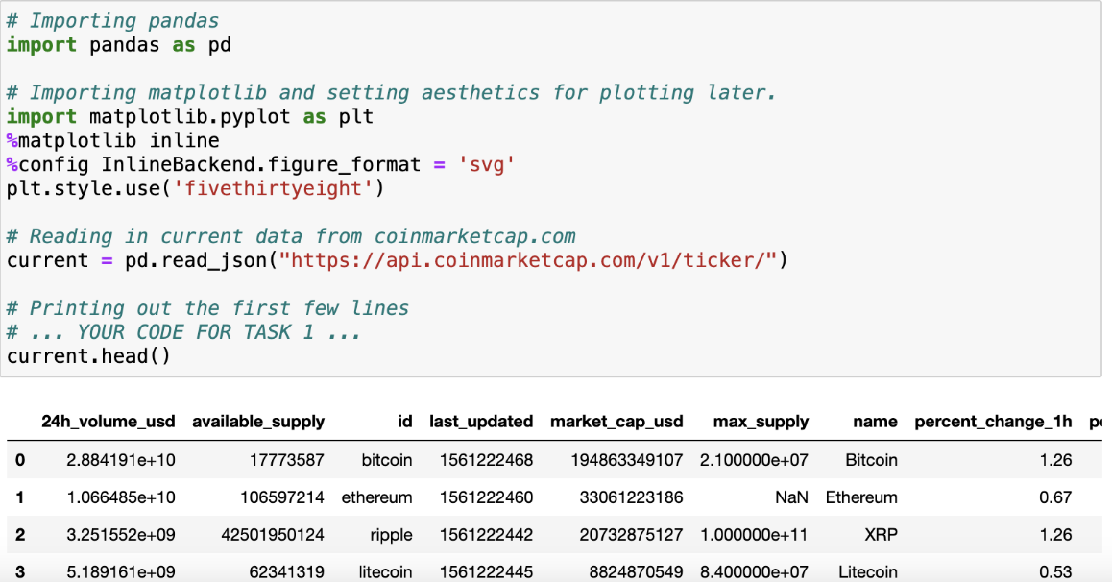
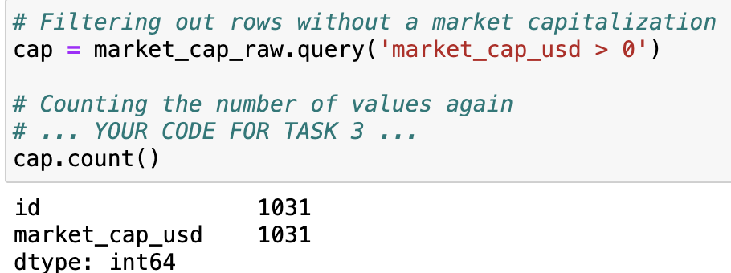
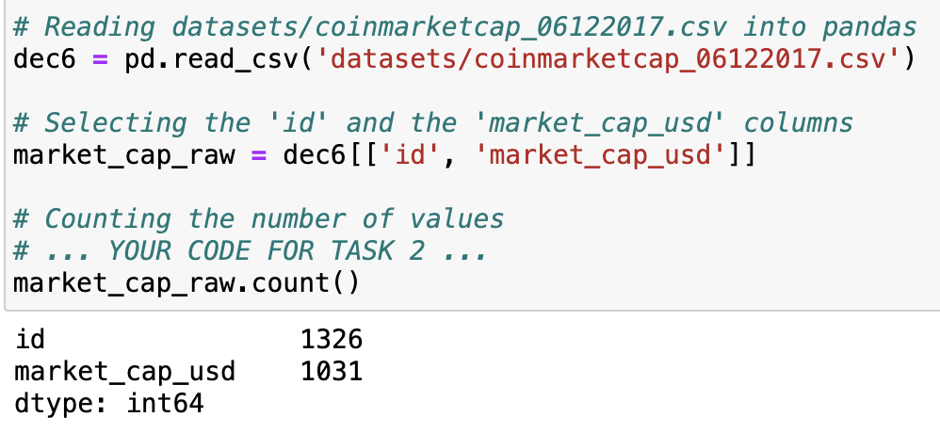
DATA PREPARATION:
These steps involve loading current and historical cryptocurrency data, selecting relevant columns, and filtering out cryptocurrencies without market capitalization. Data preparation is a crucial step before performing any analysis or visualization.

Slide 13
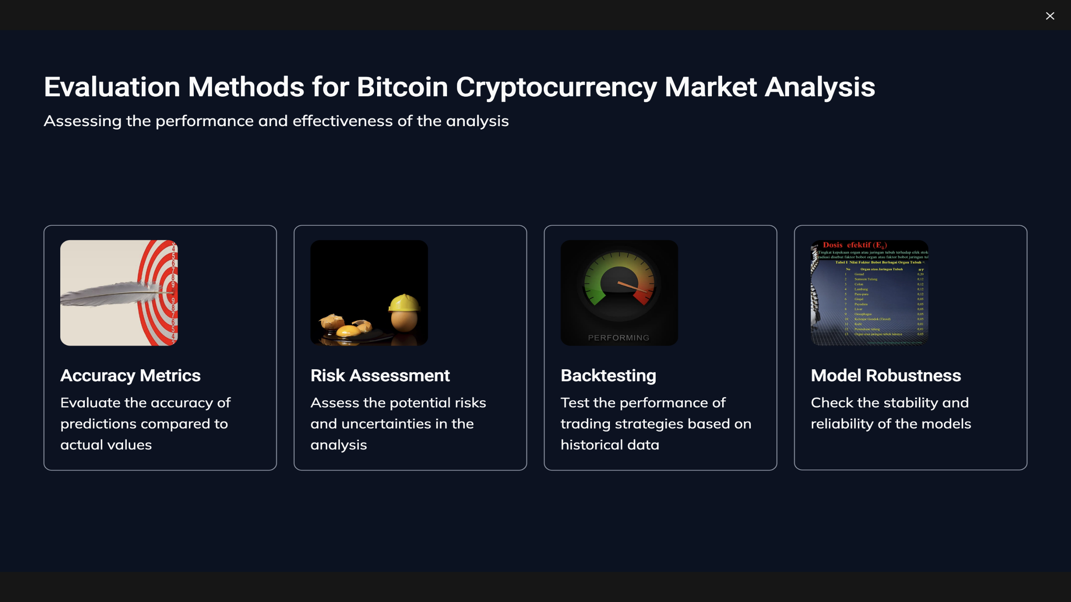

Slide 14
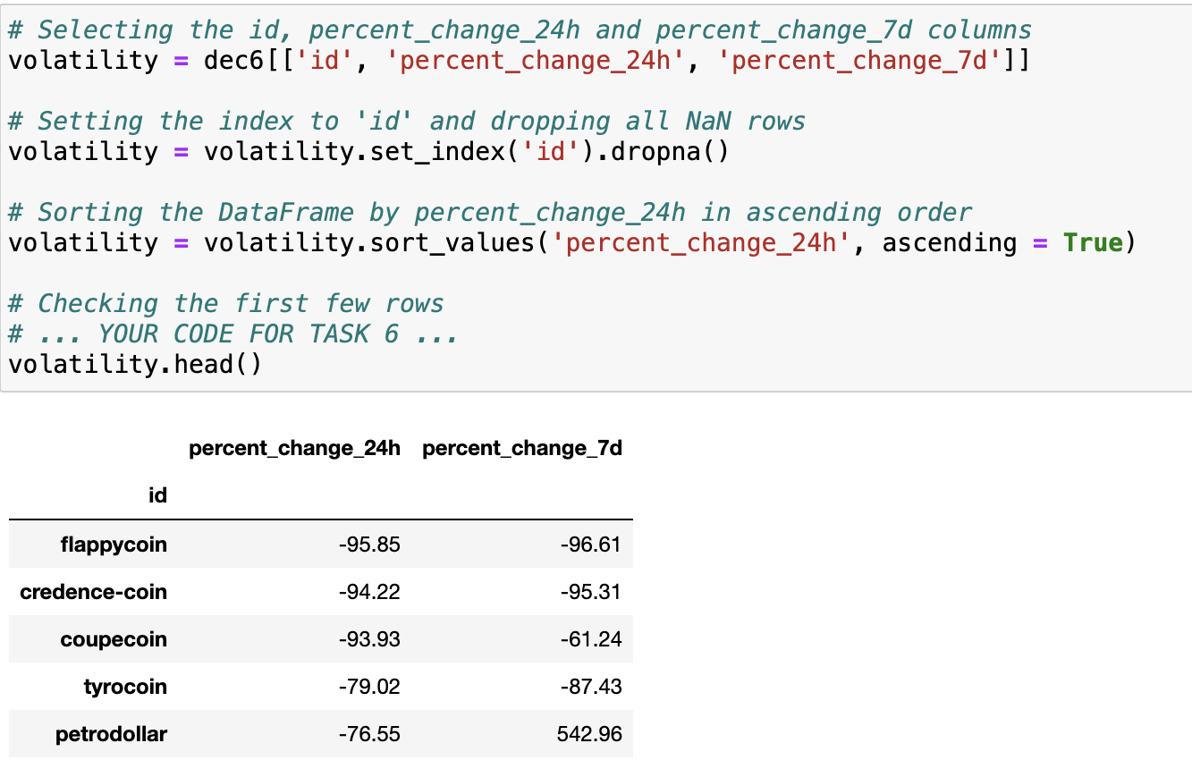
DATA EVALUATION
However, some sections indirectly contribute to data evaluation by presenting information about the cryptocurrencies, such as market capitalization changes over time and identifying the top gainers and losers.

Slide 15


Slide 16
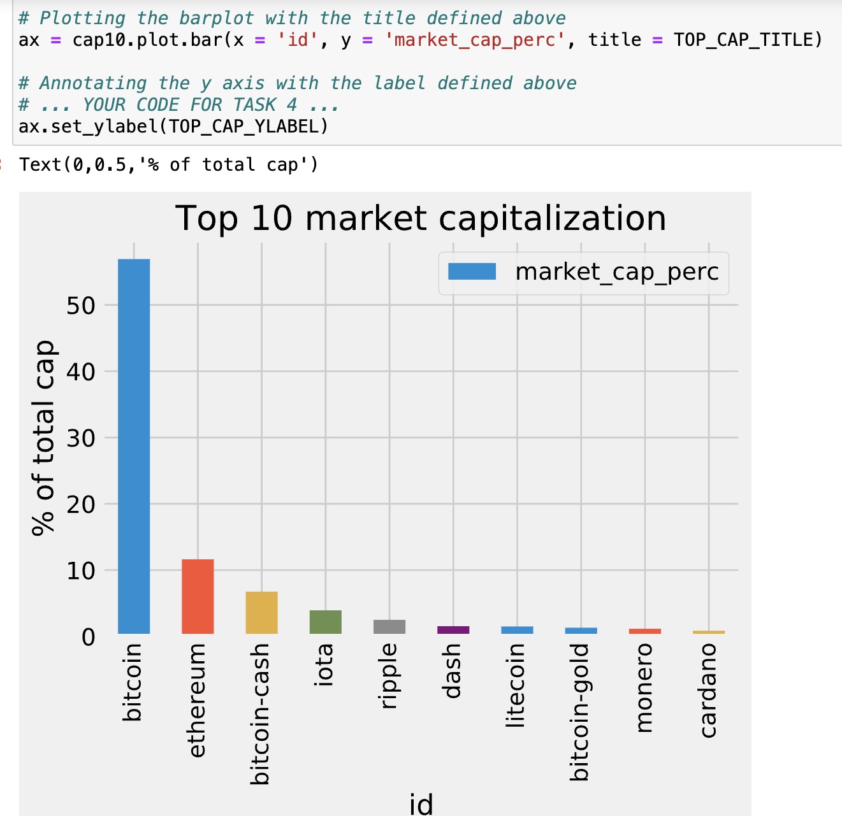
RESULTS
Plotting Market Capitalization for Top 10 Cryptocurrencies

Slide 17
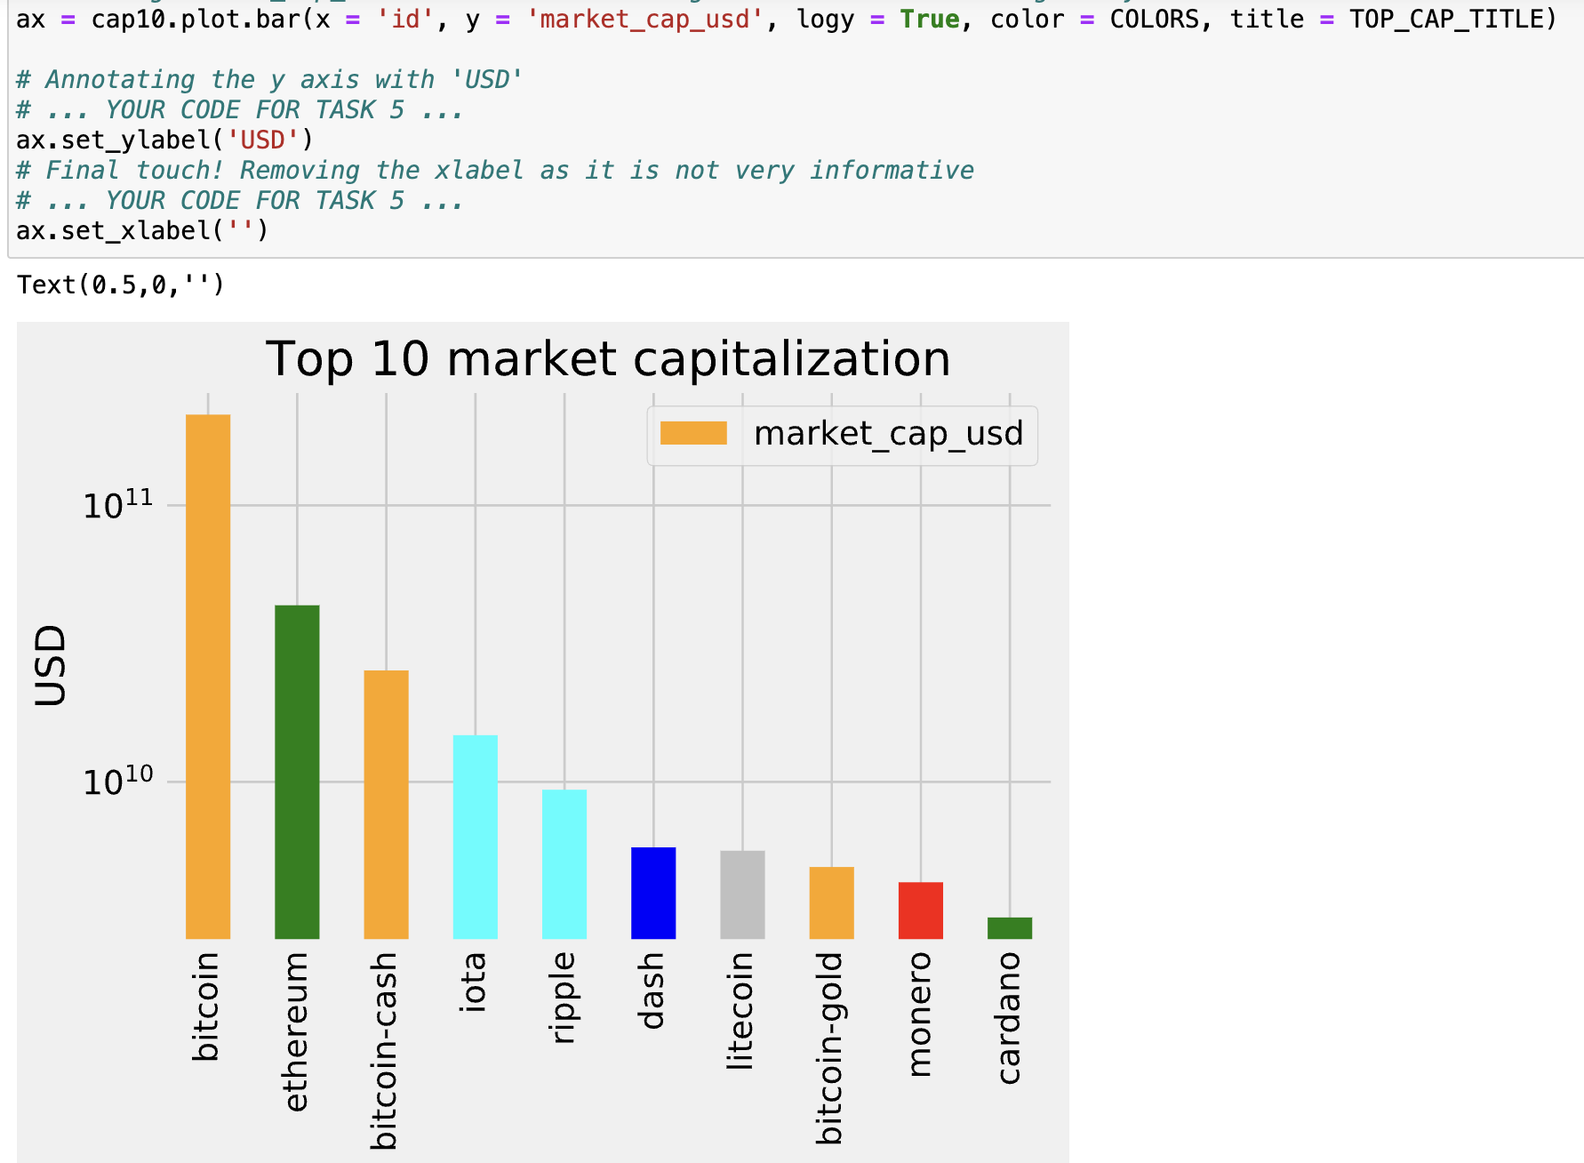
Improving the Plot for Better Readability

Slide 18
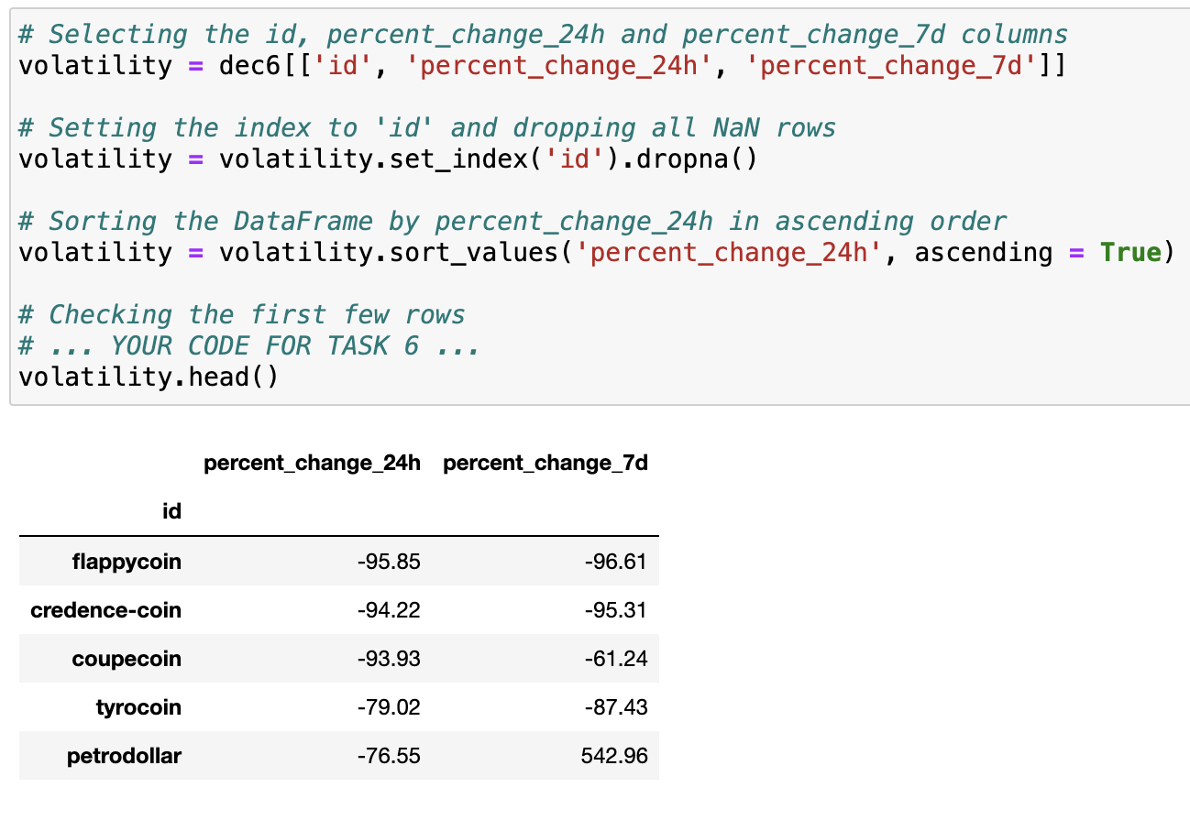
Exploring Volatility

Slide 19
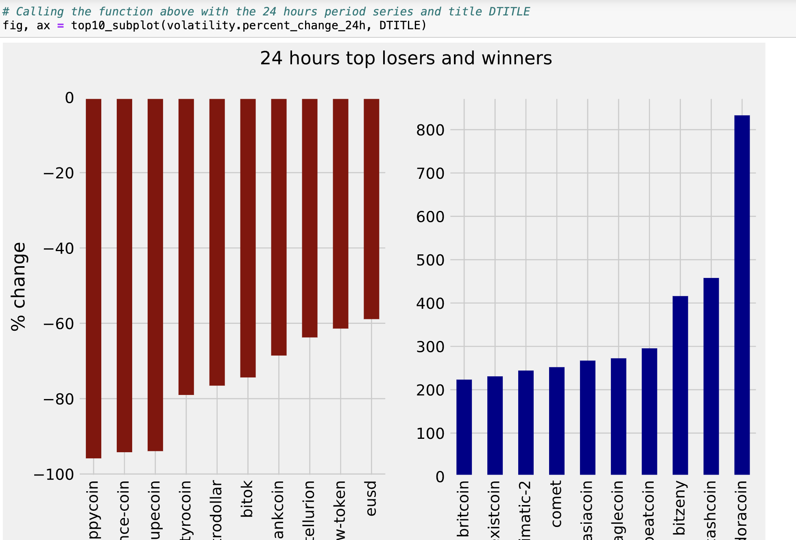
Visualizing Top Gainers and Losers

Slide 20
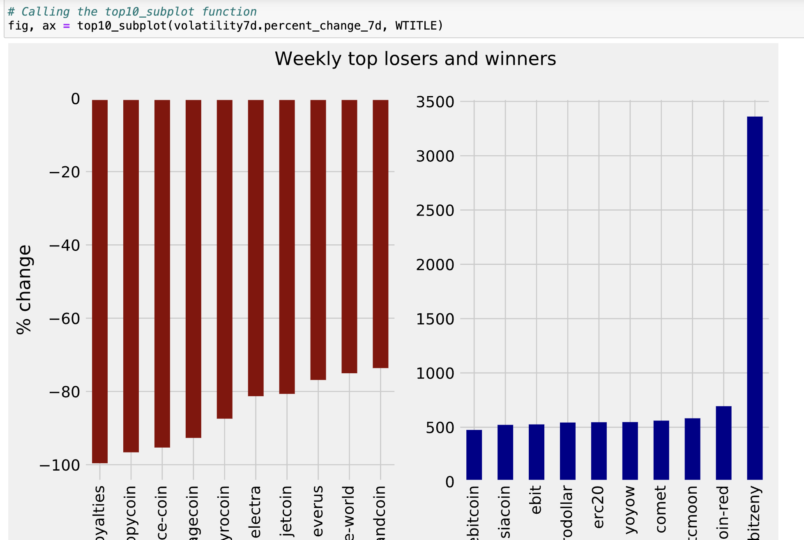
Visualizing Weekly Top Gainers and Losers

Slide 21
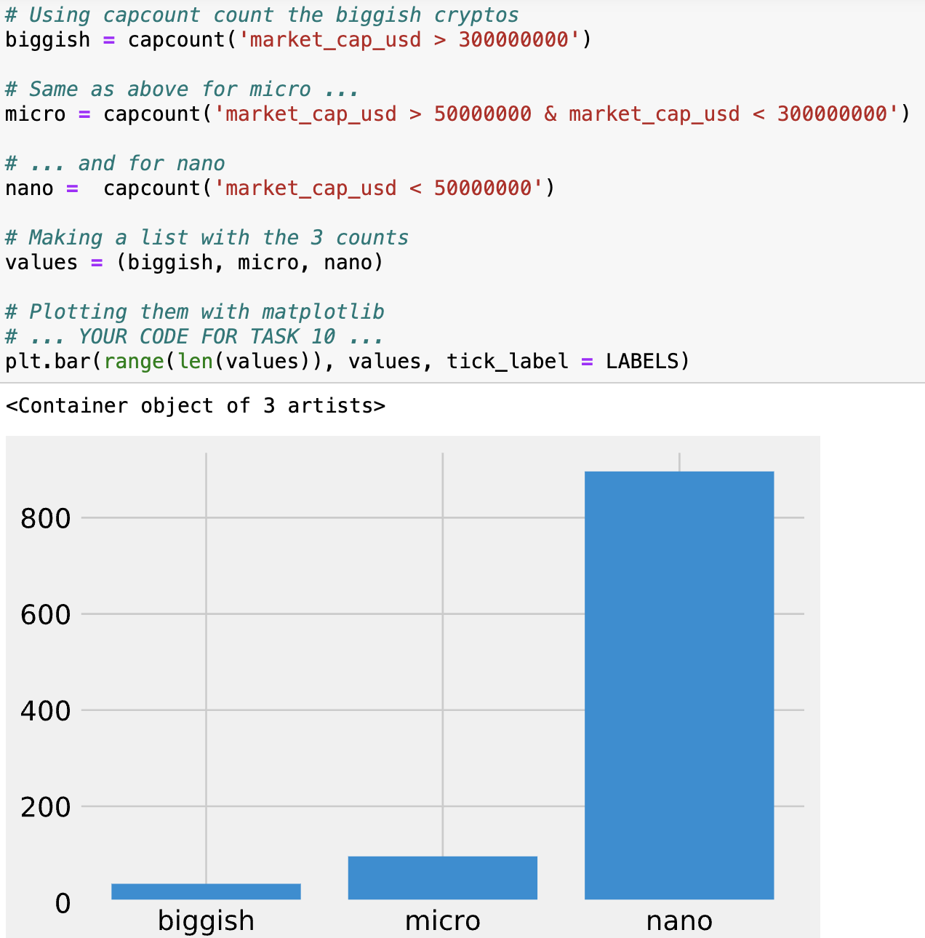
Plotting Market Capitalization Categories

Slide 22


Slide 23


